Slide 1

Mechanistic models in macroecology and biodiversity science
Petr Keil
Notes:
Hi, my name is Petr Keil and this is my project Biodiversity dynamics across a continuum of space, time, and their scales.

Slide 2
From simple rules to complex patterns
Cellular automata, fractals, deterministic chaos
Notes:
I am qualified to deliver all this

Slide 3
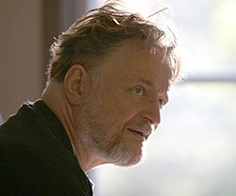
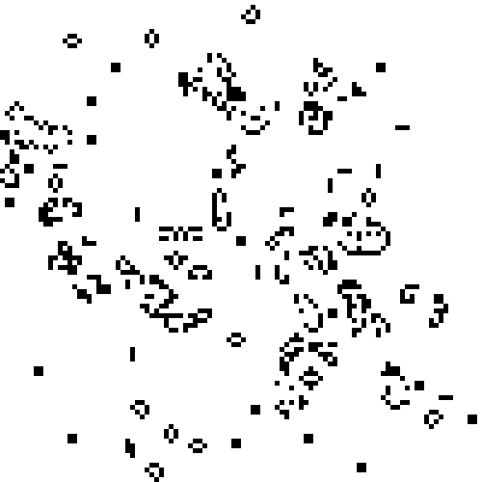
Conway’s Game of Life
John Horton Conway
(1937-2020)
Notes:
In this panel we can probably all agree that biodiversity is one of the most valuable natural resources.
But things like climate change or habitat loss are a threat to biodiversity, to the extent that we hear about biodiversity crisis, or sixth mass extinction
For example, about 1% of vertebrate species have gone extinct because of humans

Slide 4
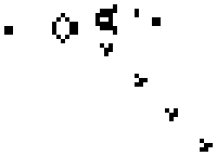
Conway’s Game of Life – simple rules
Any live cell with fewer than two live neighbours dies, as if by underpopulation.
Any live cell with two or three live neighbours lives on to the next generation.
Any live cell with more than three live neighbours dies, as if by overpopulation.
Any dead cell with exactly three live neighbours becomes a live cell, as if by reproduction.
Notes:
In this panel we can probably all agree that biodiversity is one of the most valuable natural resources.
But things like climate change or habitat loss are a threat to biodiversity, to the extent that we hear about biodiversity crisis, or sixth mass extinction
For example, about 1% of vertebrate species have gone extinct because of humans

Slide 5
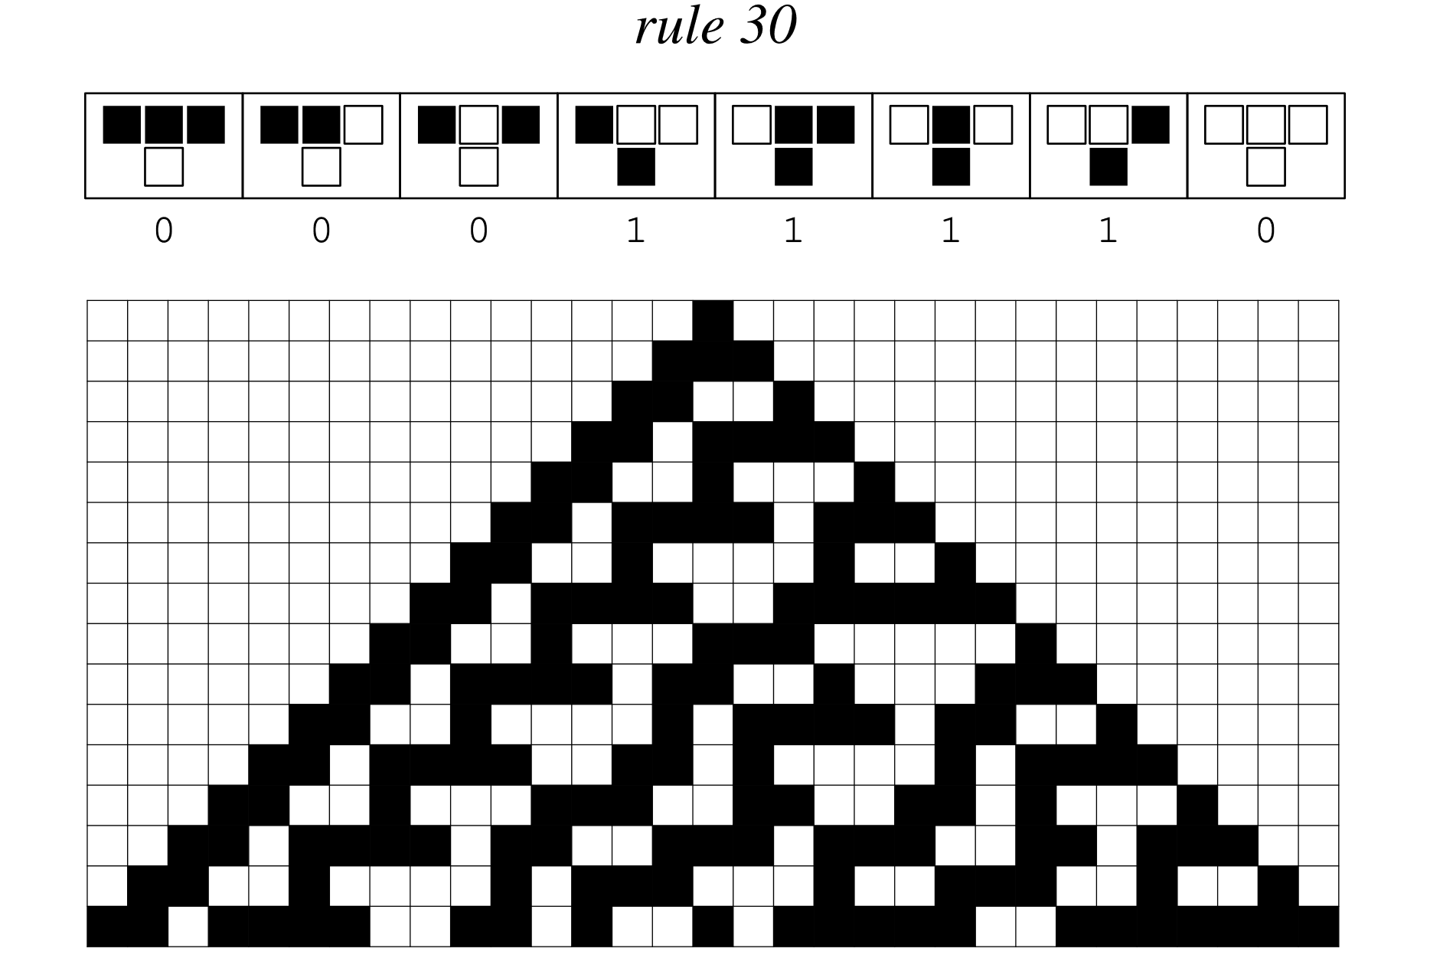
One-dimensional cellular automata
Wolfram MathWorld
Notes:
In this panel we can probably all agree that biodiversity is one of the most valuable natural resources.
But things like climate change or habitat loss are a threat to biodiversity, to the extent that we hear about biodiversity crisis, or sixth mass extinction
For example, about 1% of vertebrate species have gone extinct because of humans

Slide 6
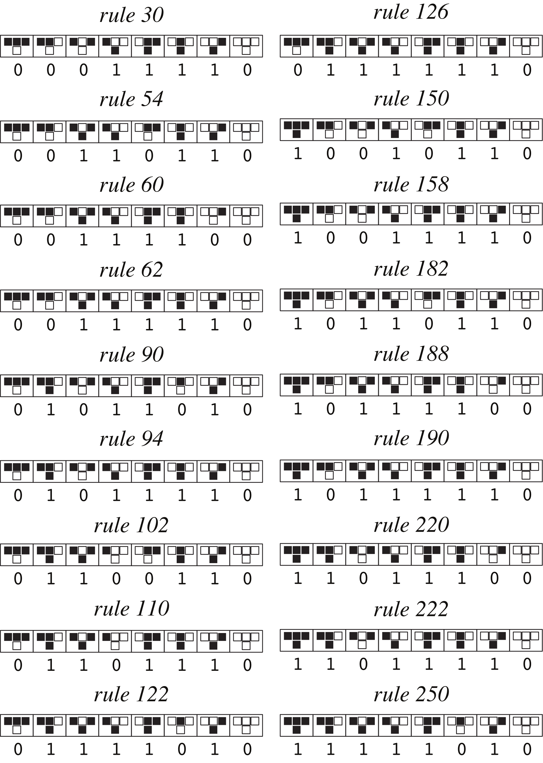
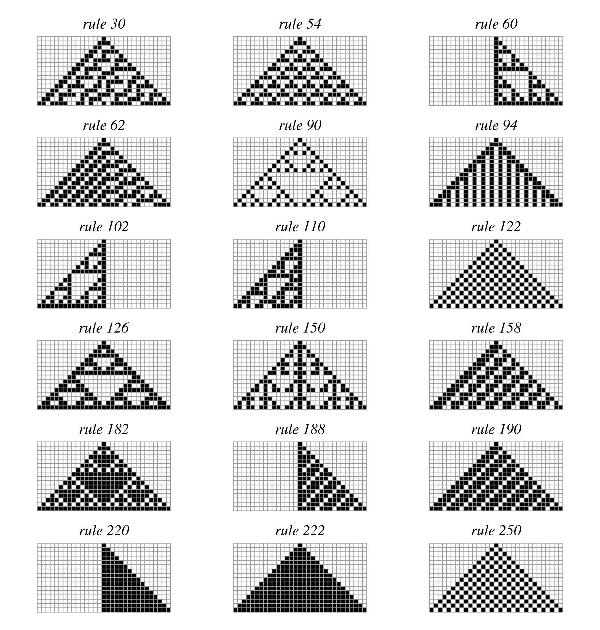
One-dimensional cellular automata
Wolfram MathWorld
Notes:
In this panel we can probably all agree that biodiversity is one of the most valuable natural resources.
But things like climate change or habitat loss are a threat to biodiversity, to the extent that we hear about biodiversity crisis, or sixth mass extinction
For example, about 1% of vertebrate species have gone extinct because of humans

Slide 7
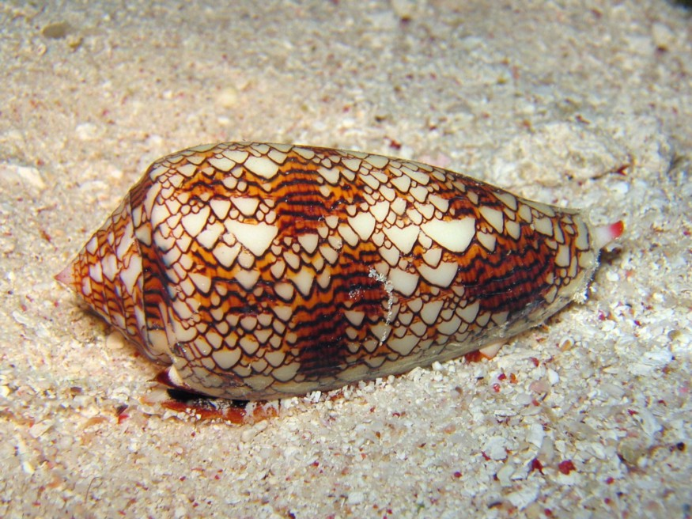
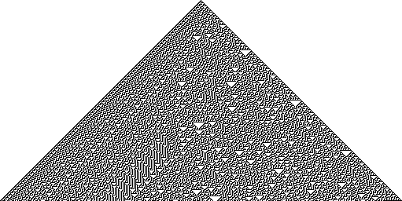
One-dimensional cellular automata
Conus abbas (homolice)
Cellular automaton “rule 30”
Liana Manukyan (1995) Nature
Notes:
In this panel we can probably all agree that biodiversity is one of the most valuable natural resources.
But things like climate change or habitat loss are a threat to biodiversity, to the extent that we hear about biodiversity crisis, or sixth mass extinction
For example, about 1% of vertebrate species have gone extinct because of humans

Slide 8
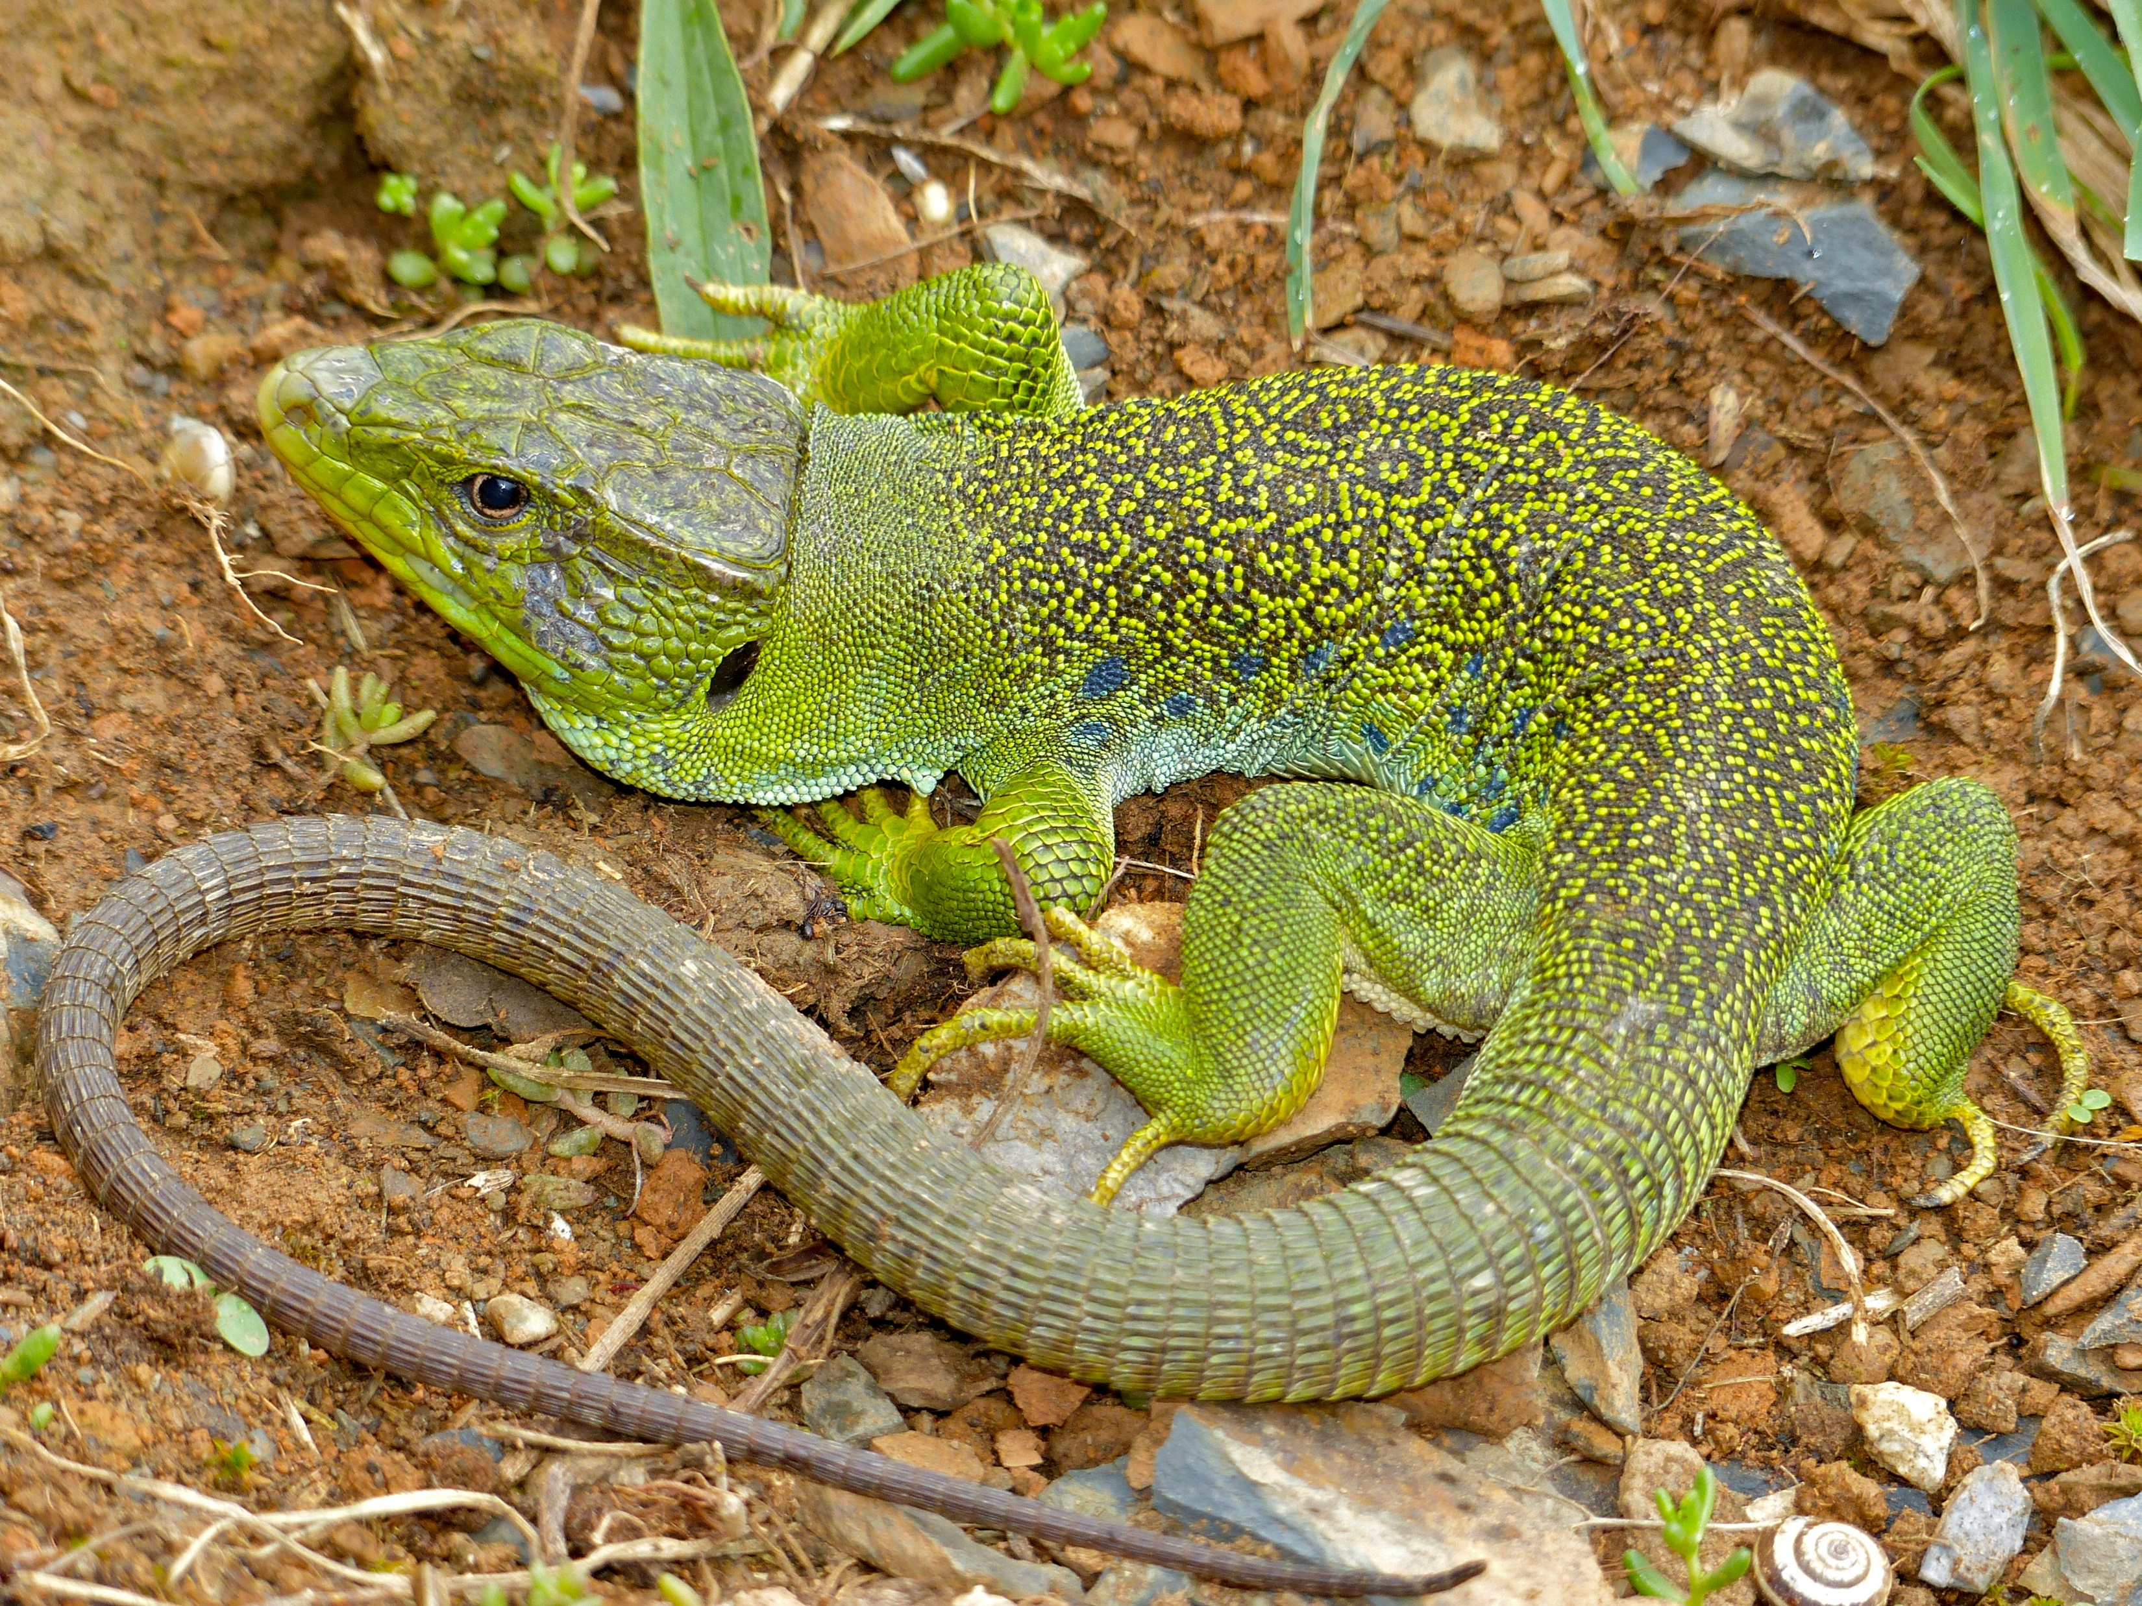
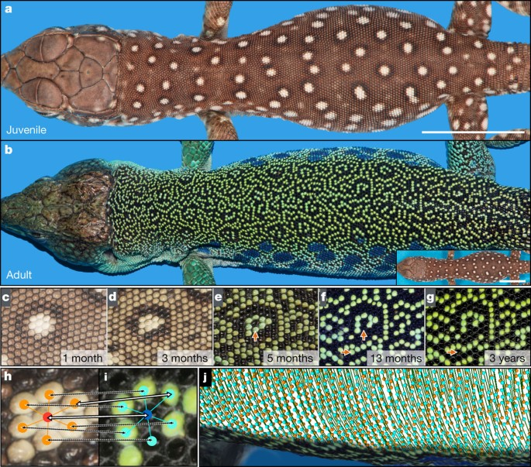
Cellular automata in nature
Manukyan et al. (2017) Nature
Timon lepidus (Ocellated lizard)
Notes:
In this panel we can probably all agree that biodiversity is one of the most valuable natural resources.
But things like climate change or habitat loss are a threat to biodiversity, to the extent that we hear about biodiversity crisis, or sixth mass extinction
For example, about 1% of vertebrate species have gone extinct because of humans

Slide 9
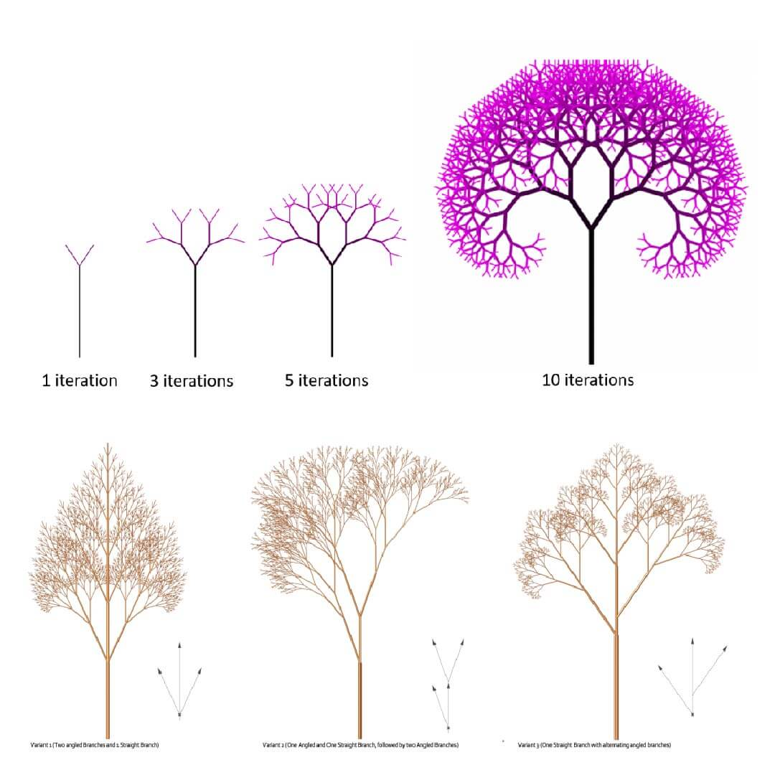
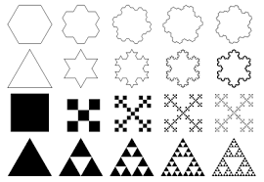
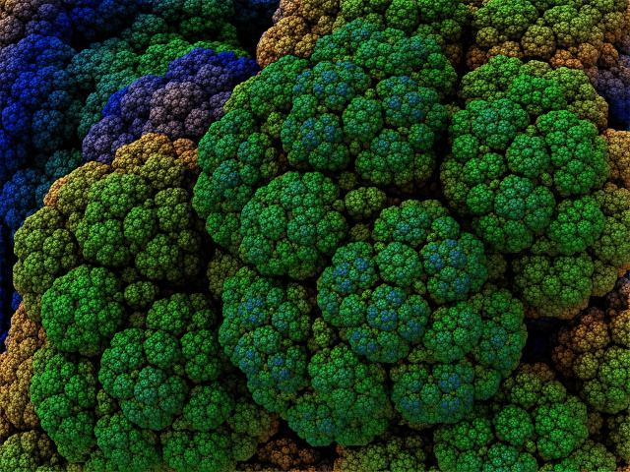
Fractals – another case of simple rules but complex outcomes
Notes:
In this panel we can probably all agree that biodiversity is one of the most valuable natural resources.
But things like climate change or habitat loss are a threat to biodiversity, to the extent that we hear about biodiversity crisis, or sixth mass extinction
For example, about 1% of vertebrate species have gone extinct because of humans

Slide 10
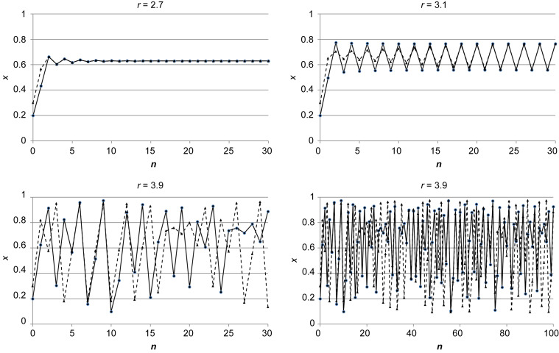
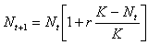
Chaotic behavior of logistic equation – from sigmoidal curve to deterministic chaos
Population size (N)
Time step (t)
Notes:
In this panel we can probably all agree that biodiversity is one of the most valuable natural resources.
But things like climate change or habitat loss are a threat to biodiversity, to the extent that we hear about biodiversity crisis, or sixth mass extinction
For example, about 1% of vertebrate species have gone extinct because of humans

Slide 11
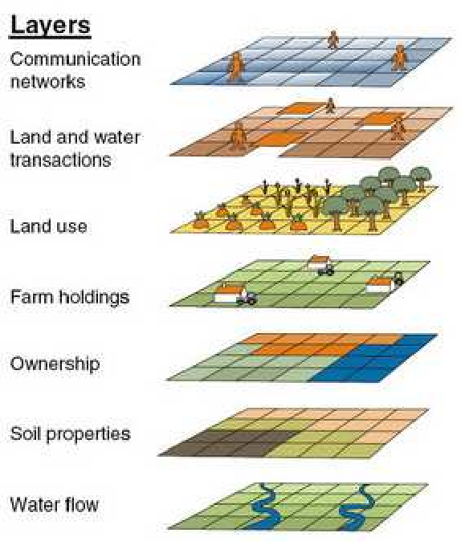
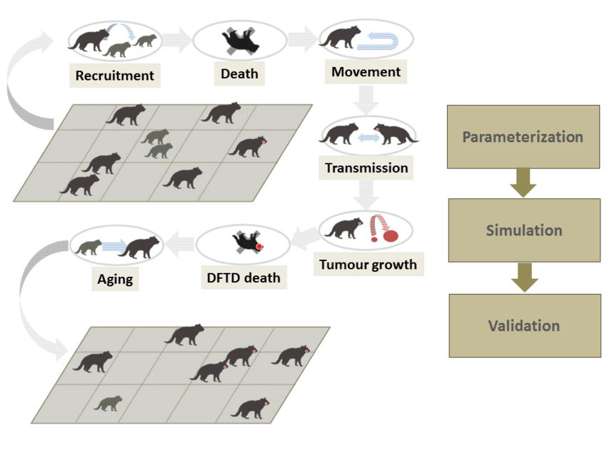
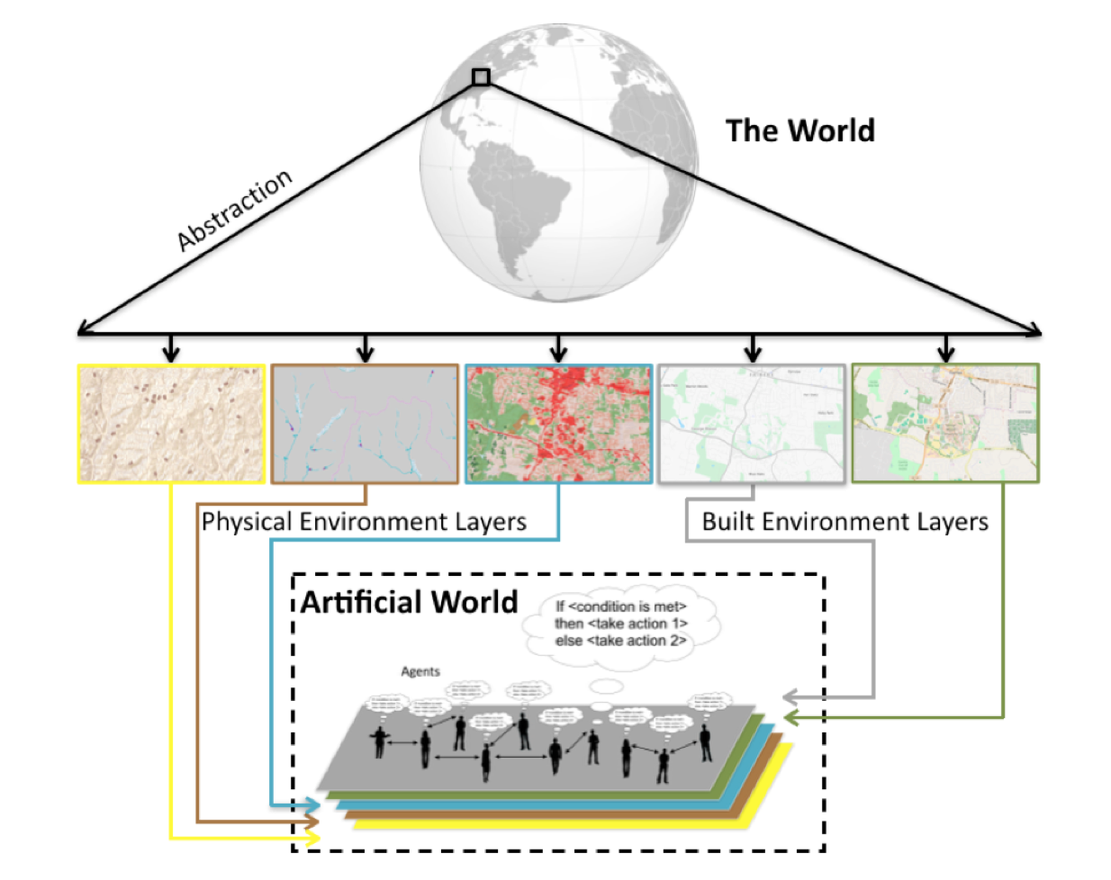
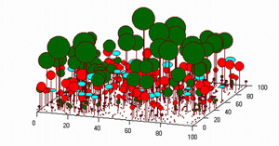
All this is different from agent-based models
Agent-based (or individual-based) models are complex models that simulate complex reality. They are related to cellular automata, but the rules are much more complex.
Grimm et al. (2005) Individual-based modelling in ecology
Notes:
In this panel we can probably all agree that biodiversity is one of the most valuable natural resources.
But things like climate change or habitat loss are a threat to biodiversity, to the extent that we hear about biodiversity crisis, or sixth mass extinction
For example, about 1% of vertebrate species have gone extinct because of humans

Slide 12
What you should know
That complex and seemingly unpredictable (“alive”) structures can emerge from simple rules
What are cellular automata, and give an example of their operation from real world
That fractals and deterministic chaos are examples of complex structures emerging from simple rules
There are individual-based (agent-based) models, which use complex rules to reproduce complex behavior
Notes:
In this panel we can probably all agree that biodiversity is one of the most valuable natural resources.
But things like climate change or habitat loss are a threat to biodiversity, to the extent that we hear about biodiversity crisis, or sixth mass extinction
For example, about 1% of vertebrate species have gone extinct because of humans

Slide 13
Unified Neutral Theory of Biodiversity
The cellular automaton for community ecology. The simplest model of nature.
Notes:
I am qualified to deliver all this

Slide 14
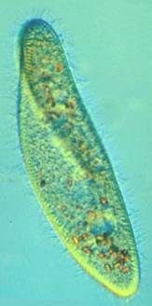
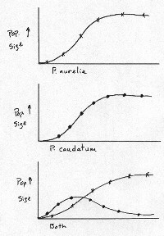
Gause’s principle of competitive exclusion
Two species or populations cannot inhabit the same niche: one will consistently out-compete the other.
When one species has even the slightest advantage over another, the one with the advantage will dominate in the long term.
Complete competitors can not coexist.
Paramecium caudatum
vs. P. aurelia
Gause G. F. (1932) Journal of Experimental Biology
Notes:
In this panel we can probably all agree that biodiversity is one of the most valuable natural resources.
But things like climate change or habitat loss are a threat to biodiversity, to the extent that we hear about biodiversity crisis, or sixth mass extinction
For example, about 1% of vertebrate species have gone extinct because of humans

Slide 15
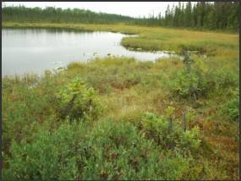
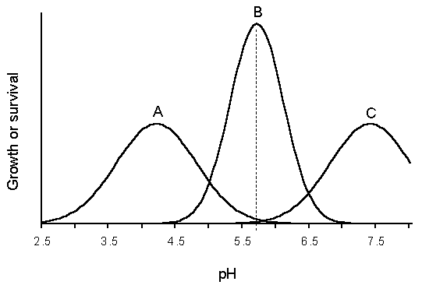
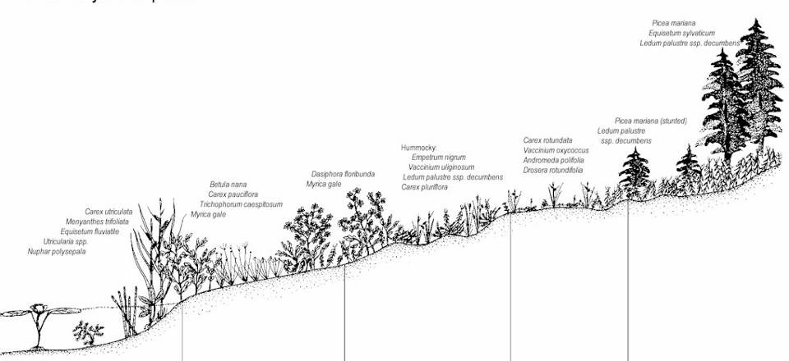
So how can species coexist? Thanks to the heterogeneity of environment
Humididy gradient
Notes:
In this panel we can probably all agree that biodiversity is one of the most valuable natural resources.
But things like climate change or habitat loss are a threat to biodiversity, to the extent that we hear about biodiversity crisis, or sixth mass extinction
For example, about 1% of vertebrate species have gone extinct because of humans

Slide 16
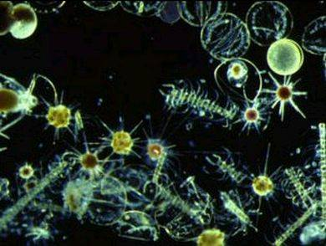
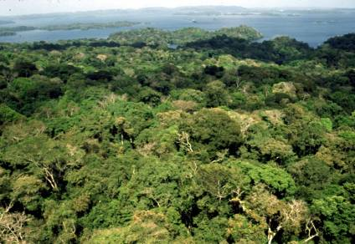
But there is the paradox of the plankton, tropical forests …
Many species with similar niches coexist in homogeneous environments. How is that possible?
Hutchinson (1961)
Notes:
In this panel we can probably all agree that biodiversity is one of the most valuable natural resources.
But things like climate change or habitat loss are a threat to biodiversity, to the extent that we hear about biodiversity crisis, or sixth mass extinction
For example, about 1% of vertebrate species have gone extinct because of humans

Slide 17
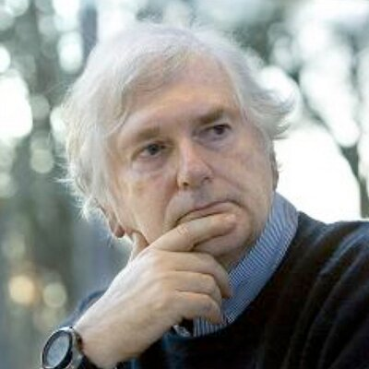
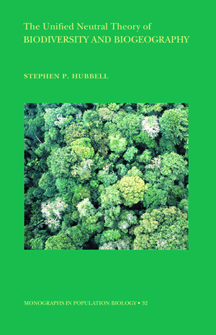
Paradox of the plankton, tropical forests
Stephen P. Hubbell
UCLA
Hubbell (2001) The Unified Neutral Theory of Biodiversity and Biogeography
Notes:
In this panel we can probably all agree that biodiversity is one of the most valuable natural resources.
But things like climate change or habitat loss are a threat to biodiversity, to the extent that we hear about biodiversity crisis, or sixth mass extinction
For example, about 1% of vertebrate species have gone extinct because of humans

Slide 18
The neutral model
Rosindell et al. (2011) Trends in Ecology & Evolution
Notes:
In this panel we can probably all agree that biodiversity is one of the most valuable natural resources.
But things like climate change or habitat loss are a threat to biodiversity, to the extent that we hear about biodiversity crisis, or sixth mass extinction
For example, about 1% of vertebrate species have gone extinct because of humans

Slide 19
A neutral model
Metacommunity
Local community
Notes:
In this panel we can probably all agree that biodiversity is one of the most valuable natural resources.
But things like climate change or habitat loss are a threat to biodiversity, to the extent that we hear about biodiversity crisis, or sixth mass extinction
For example, about 1% of vertebrate species have gone extinct because of humans

Slide 20
A neutral model
Metacommunity
1. Mortality (disturbance)
Local community
Notes:
In this panel we can probably all agree that biodiversity is one of the most valuable natural resources.
But things like climate change or habitat loss are a threat to biodiversity, to the extent that we hear about biodiversity crisis, or sixth mass extinction
For example, about 1% of vertebrate species have gone extinct because of humans

Slide 21
A classic neutral model
Metacommunity
1. Mortality (disturbance)
Local community
Notes:
In this panel we can probably all agree that biodiversity is one of the most valuable natural resources.
But things like climate change or habitat loss are a threat to biodiversity, to the extent that we hear about biodiversity crisis, or sixth mass extinction
For example, about 1% of vertebrate species have gone extinct because of humans

Slide 22
A classic neutral model
Metacommunity
1. Mortality (disturbance)
Local community
2. Colonization
(from within the local community, and from other communities)
3. Speciation
(an existing species splits to two)
Notes:
In this panel we can probably all agree that biodiversity is one of the most valuable natural resources.
But things like climate change or habitat loss are a threat to biodiversity, to the extent that we hear about biodiversity crisis, or sixth mass extinction
For example, about 1% of vertebrate species have gone extinct because of humans

Slide 23
A classic neutral model
Metacommunity
1. Mortality (disturbance)
Local community
2. Colonization
(from within the local community, and from other communities)
3. Speciation
(an existing species splits to two)
Notes:
In this panel we can probably all agree that biodiversity is one of the most valuable natural resources.
But things like climate change or habitat loss are a threat to biodiversity, to the extent that we hear about biodiversity crisis, or sixth mass extinction
For example, about 1% of vertebrate species have gone extinct because of humans

Slide 24
The neutral model produces realistic patterns (sometimes)
Rosindell et al. (2011) Trends in Ecology & Evolution
Notes:
In this panel we can probably all agree that biodiversity is one of the most valuable natural resources.
But things like climate change or habitat loss are a threat to biodiversity, to the extent that we hear about biodiversity crisis, or sixth mass extinction
For example, about 1% of vertebrate species have gone extinct because of humans

Slide 25
What you should know
According to Gause’s principle of competitive exclusion, two species with similar niches should not be able to coexist in a homogeneous environment
Environmental heterogeneity and niche differences enable coexistence
But there is the paradox of the plankton, where similar species coexist in homogeneous environment
The unified neutral theory of biodiversity (UNTB) offers a cellular automaton that resolves the paradox
UNTB sometimes predicts realistic shapes of species-area relationship and species-abundance distributions
Notes:
In this panel we can probably all agree that biodiversity is one of the most valuable natural resources.
But things like climate change or habitat loss are a threat to biodiversity, to the extent that we hear about biodiversity crisis, or sixth mass extinction
For example, about 1% of vertebrate species have gone extinct because of humans

Slide 26
Null models
An example of elevation gradient of species richness
Notes:
I am qualified to deliver all this

Slide 27
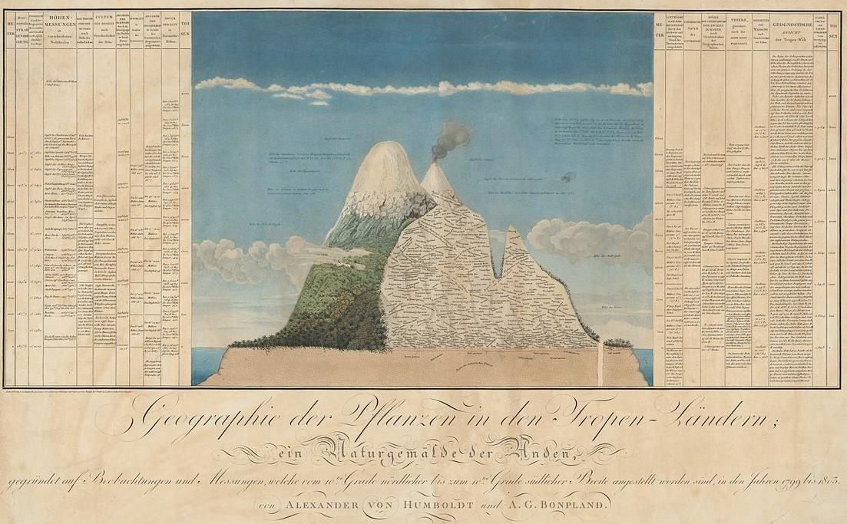
Elevational gradient of species richness
Rahbek (1995) Ecography
Notes:
In this panel we can probably all agree that biodiversity is one of the most valuable natural resources.
But things like climate change or habitat loss are a threat to biodiversity, to the extent that we hear about biodiversity crisis, or sixth mass extinction
For example, about 1% of vertebrate species have gone extinct because of humans

Slide 28
Elevational gradient of species richness
Why does the hump-shaped pattern emerge?
Quintero & Jetz (2018) Nature
Notes:
In this panel we can probably all agree that biodiversity is one of the most valuable natural resources.
But things like climate change or habitat loss are a threat to biodiversity, to the extent that we hear about biodiversity crisis, or sixth mass extinction
For example, about 1% of vertebrate species have gone extinct because of humans

Slide 29
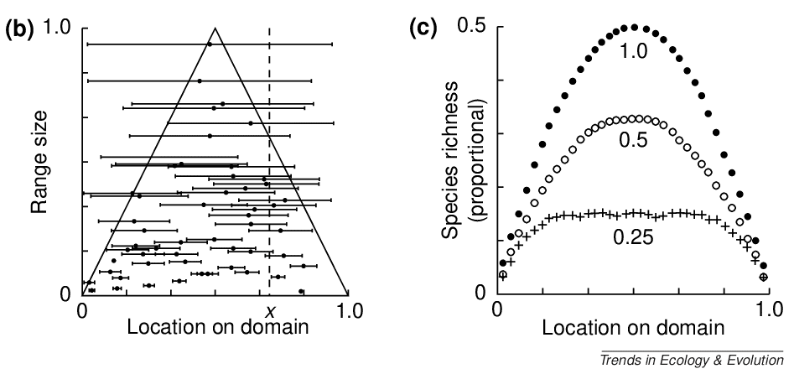
The mid-domain effect – example of a pattern that emerges from purely geometrical reasons
The increasing overlap of species ranges towards the centre of a shared geographic domain due to geometric boundary constraints in relation to the distribution of species' range sizes and midpoints.
Colwell & Lees (2000) Trends in Ecology & Evolution
Notes:
In this panel we can probably all agree that biodiversity is one of the most valuable natural resources.
But things like climate change or habitat loss are a threat to biodiversity, to the extent that we hear about biodiversity crisis, or sixth mass extinction
For example, about 1% of vertebrate species have gone extinct because of humans

Slide 30
What is a null model?
In mathematics, for example in the study of statistical properties of graphs, a null model is a type of random object that matches one specific object in some of its features, or more generally satisfies a collection of constraints, but which is otherwise taken to be an unbiasedly random structure.
In ecology, null models are usually the simplest models that can be derived from first principles and constraints. They usually contain very little biology.
Null models can serve as a foundation for our understanding of nature. If the null model reproduces the empirically observed patterns, then do we need biology/ecology at all?
They can also be the simplest computational frame (vehicle) on which we can build more complex models.
Random range placement (the mid-domain effect model) is an example of a simple model that reproduces the hump-shaped pattern of species richness along elevation. The model is also wrong, by the way (Sizling, Storch & Keil 2011, Ecology).
Notes:
In this panel we can probably all agree that biodiversity is one of the most valuable natural resources.
But things like climate change or habitat loss are a threat to biodiversity, to the extent that we hear about biodiversity crisis, or sixth mass extinction
For example, about 1% of vertebrate species have gone extinct because of humans

Slide 31
Thank you. Questions?
Notes:
I am qualified to deliver all this

